Slide 1
Input Data
General Code
Output Data
Dependency
Project Setup
Workflow
Application
Installation: install.R
Common Functions
Find Environment
Install Packages
Set Project Root
Numeric Data (Tabular)
Rows: Samples
Columns: Features
Metadata (Tabular)
Rows: Samples
Columns: Features
Preprocessing: preprocess.R
Row / Sample Subsets
Column / Feature Subsets
Scaling [Log2, Linear]
Normalization [Global Min Max, Local Min Max, Global Z-Score, Local Z-Score, Quartile]
App Initialization: app.R
Access: authentication.R
UI Functions: ui_functions.R
Interface Options: options.R
Connect Storage: storage.R
Workflows: workflows.R
Store Workflow Roots
Create Directories
Update Source Code
Run & Deploy App
Postprocessing
Import Reduced Datasets
Calculate Metadata Filters
Colors, Shapes, Labels
Apply User Parameters
Utility Functions: utils.R
Load Packages
Common Functions
Connect to AWS S3
Set Analysis Options
Reduction: red_methods.R
PCA [10D, Summary, tSNE]
VAE [10D, Summary, tSNE]
UMAP [10D, Summary, tSNE]
PHATE [2D, 3D]
Thresholding Sets [UpSetR]
Plotting: plotting.R
Static 2D: ggplot2
Interactive: plotly
Boxplots: beeswarm
Heatmaps: heatmaply
Intersections: VennDiagram
Data Tables: DT
Import Data: converter.R
Citations, Credentials
Datasets [Categories]
Row / Column Subsets
Numeric Data
Metadata
Local / AWS Storage: packaging.R
Load Visualization Data
Compartmentalize Tables
Create Keys (folders, file names)
Save to Folder / Bucket

Slide 2
install.R*: Declares functions, determines the environment, installs packages, and sets root.
converter.R: Standardizes data for downstream processing and generates app configuration files.
find_replace.R*: Declares functions for finding / replacing fixed / regex expressions in text.
library(shiny), library(dplyr), library(BiocManager) [only necessary for reduction]
library(stringi)
storage.R*: Declares functions to list, find, read, and write files on operating systems / AWS.
text_work.R: Declares functions for identifying bookmarkable elements, manipulating menu text.
validation.R: Validates numeric data / metadata tables.
library(aws.s3)
preprocess.R: Names and initializes reduction parameters. Names, stores, and loads reduction files.
ui_functions.R: Declares functions that generate interactive HTML widgets for Shiny applications.
workflows.R*: Manage folders & app deployment for each workflow.
library(shinycssloaders), library(shinywidgets)
make_requests.R: Loads stored category / subset data. Declares functions for validating, creating, combining, and identifying reduction requests.
options.R: Tests storage systems, generates menus, and assembles user interfaces for the application.
red_methods.R*: Implements PCA, VAE, UMAP, PHATE, Sets, and tSNE as reduction methods.
authentication.R*: Manages user authentication for the application.
library(shinyjs), library(shinydashboard)
library(reticulate), library(tensorflow), library(keras), library(phateR), library(umap), library(Rtsne), library(Matrix)
red_requests.R*: Declares functions for efficiently performing and storing reduction requests.
library(bcrypt)
app.R: Makes an interactive Shiny application capable of visualizing dimensionally reduced data.
plotting.R*: Makes ggplot2, plotly, boxplot / beeswarm, DT, UpSetR, heatmaply, and Venn Diagram objects for Shiny applications.
packaging.R: Assembles a broad set of reduction requests, executes them, and syncs data to AWS.
sca_nor_fun.R*: Declares scaling / normalization functions.
library(limma)
library(viridis), library(ggplot2), library(plotly), library(UpSetR), library(VennDiagram),
library(beeswarm), library(heatmaply), library(DT)
*Has unit tests.

Slide 3
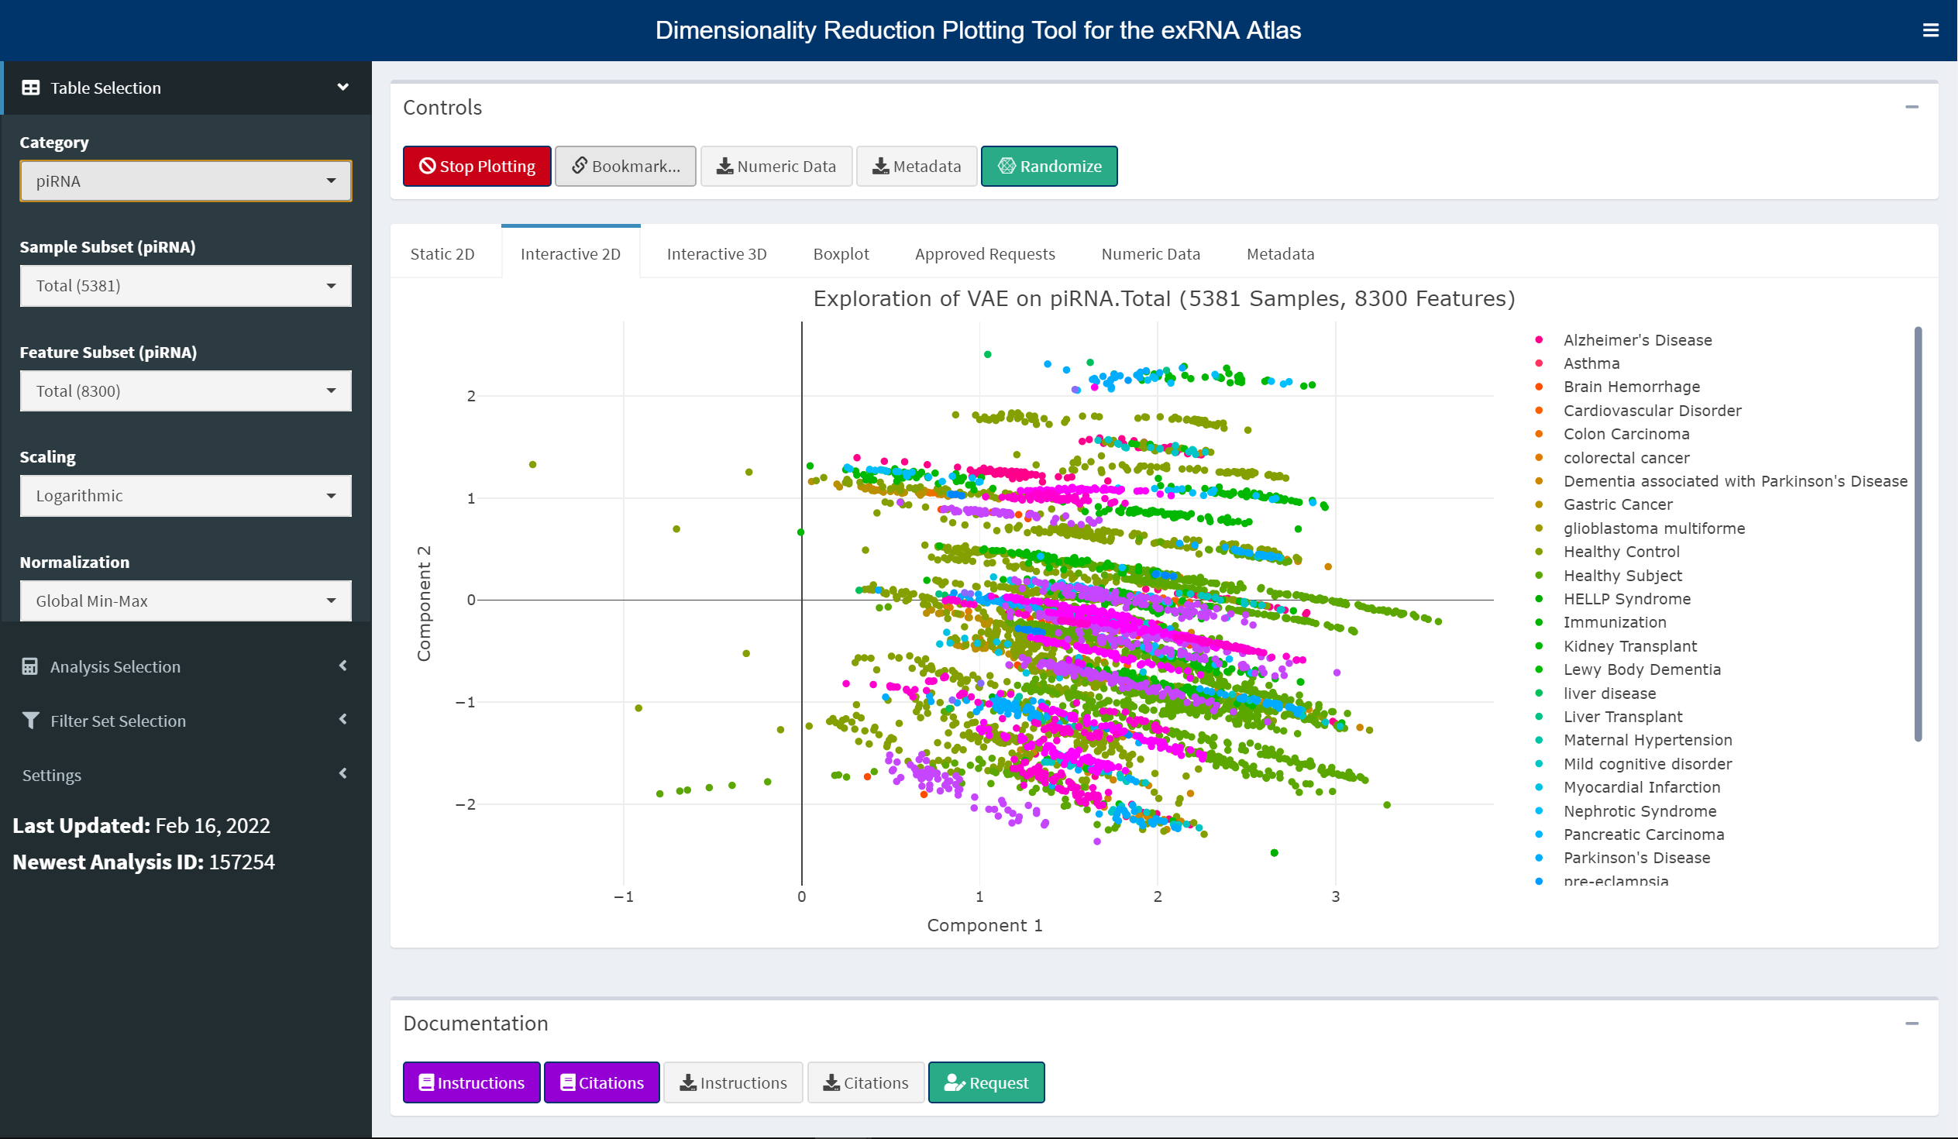
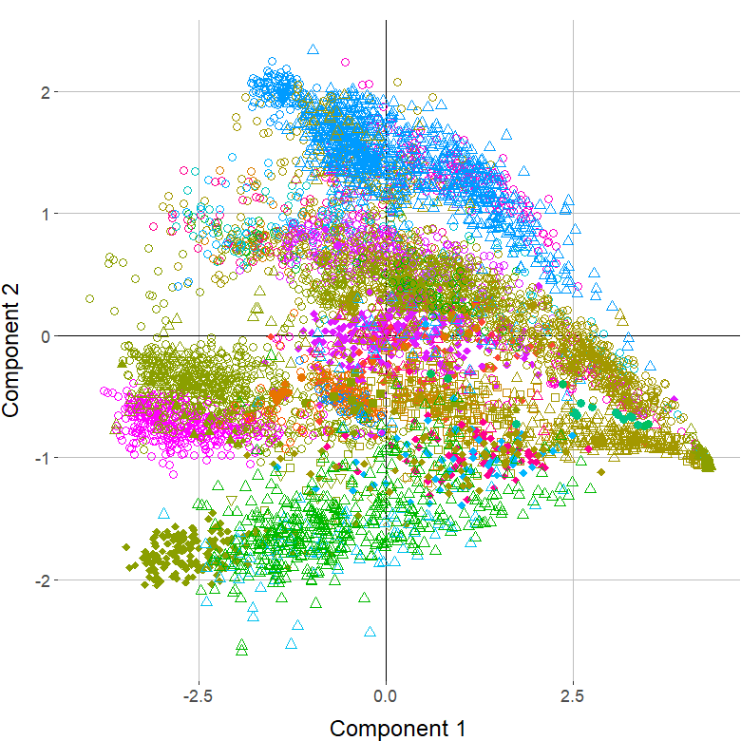
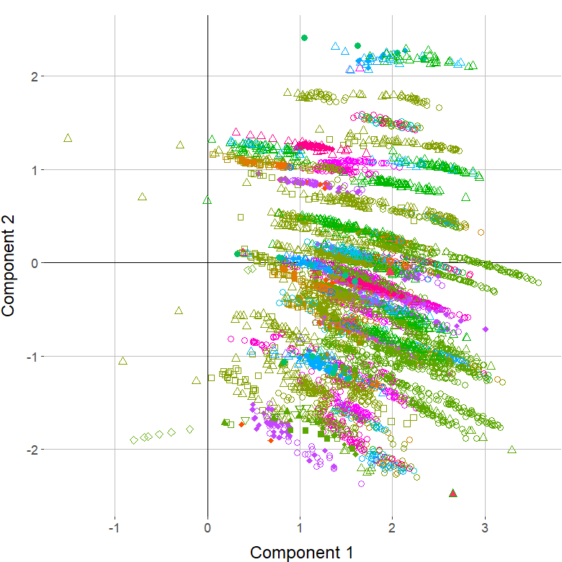
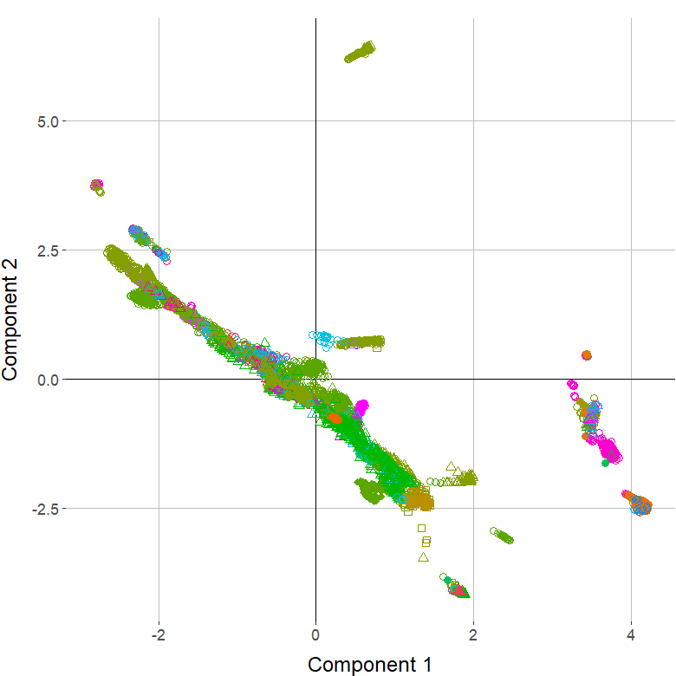
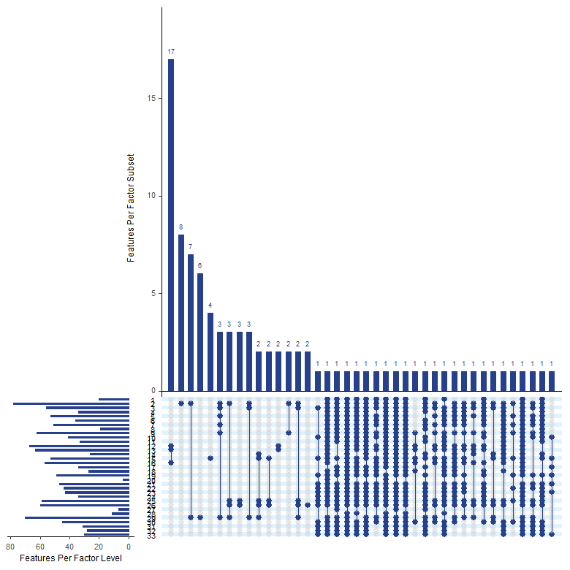
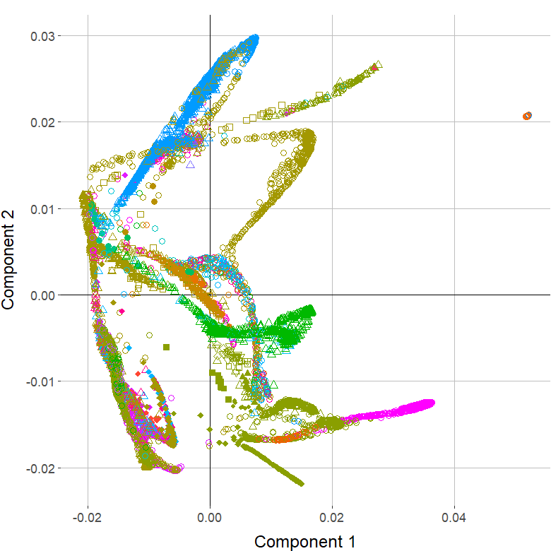
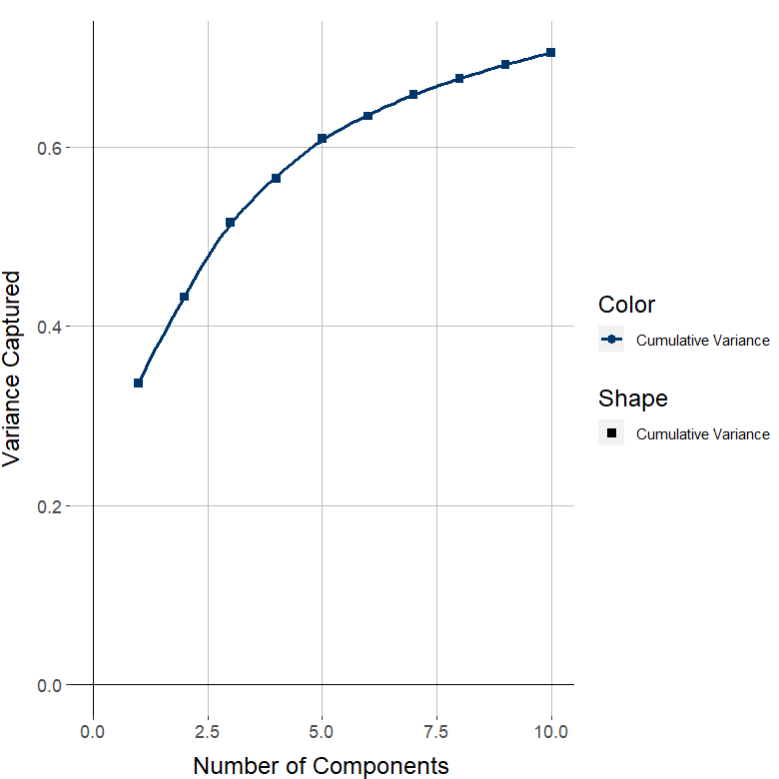
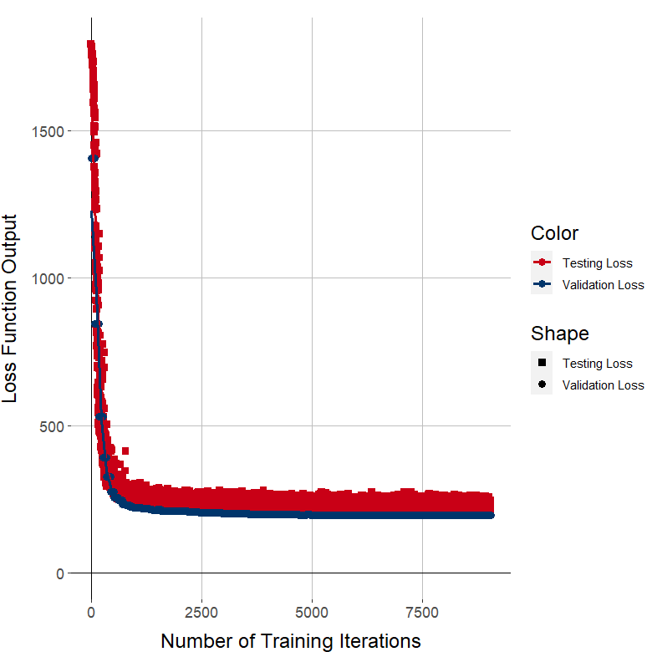
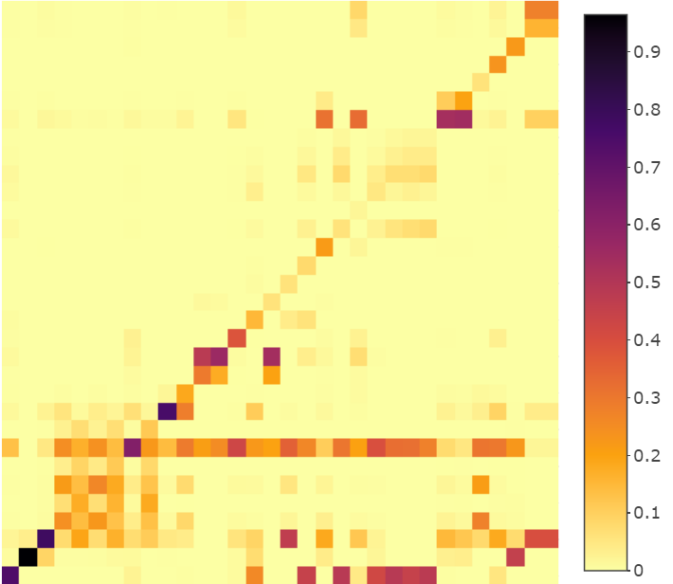
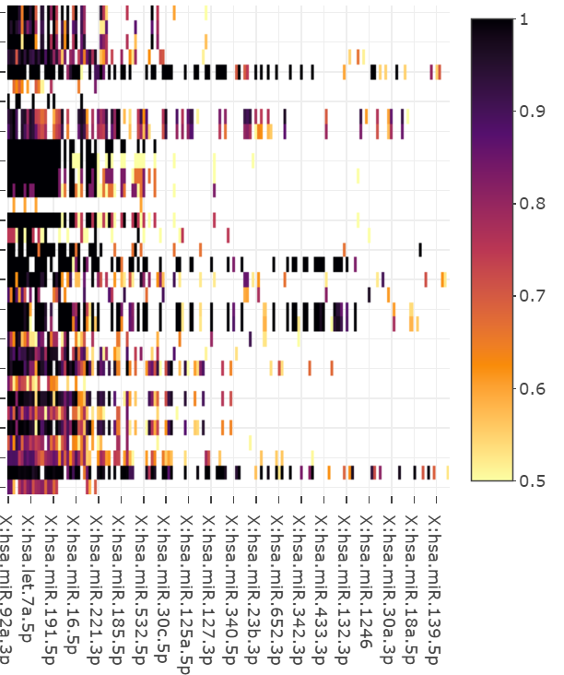
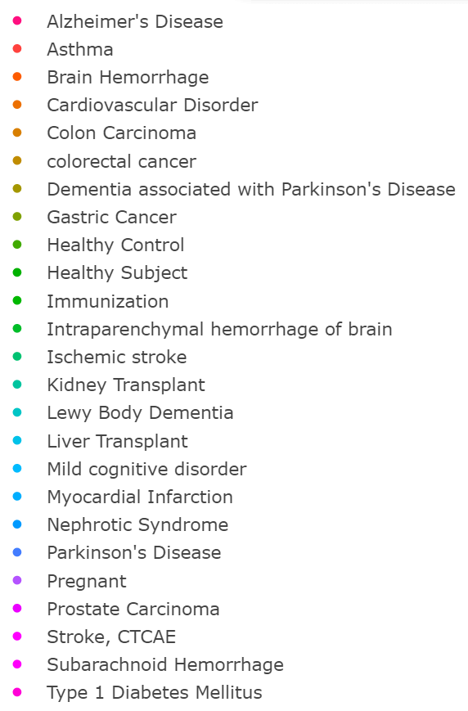
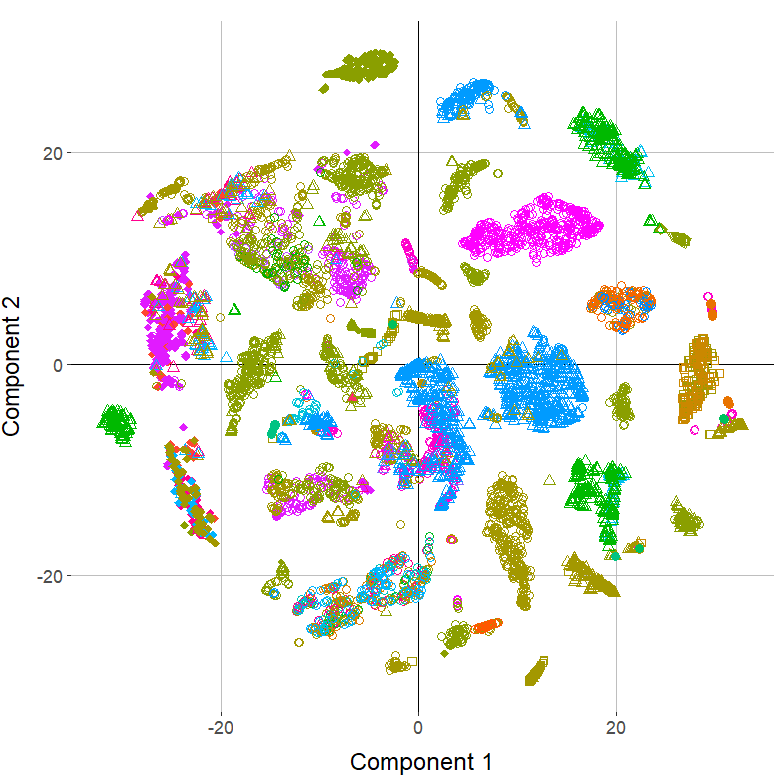
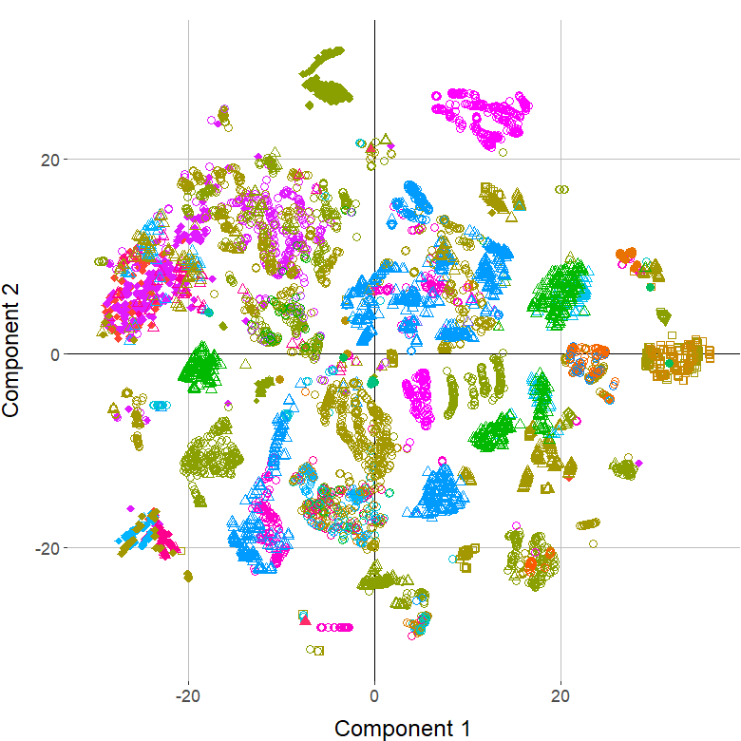
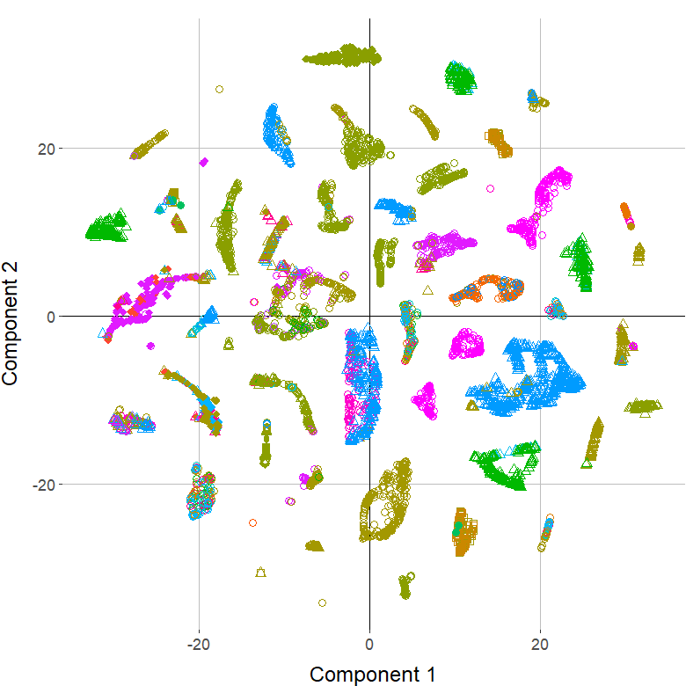
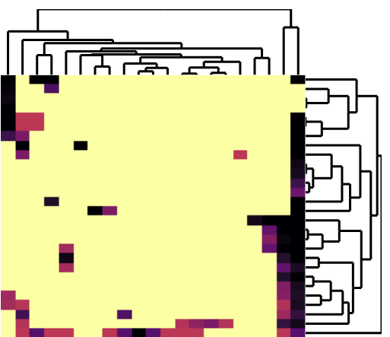
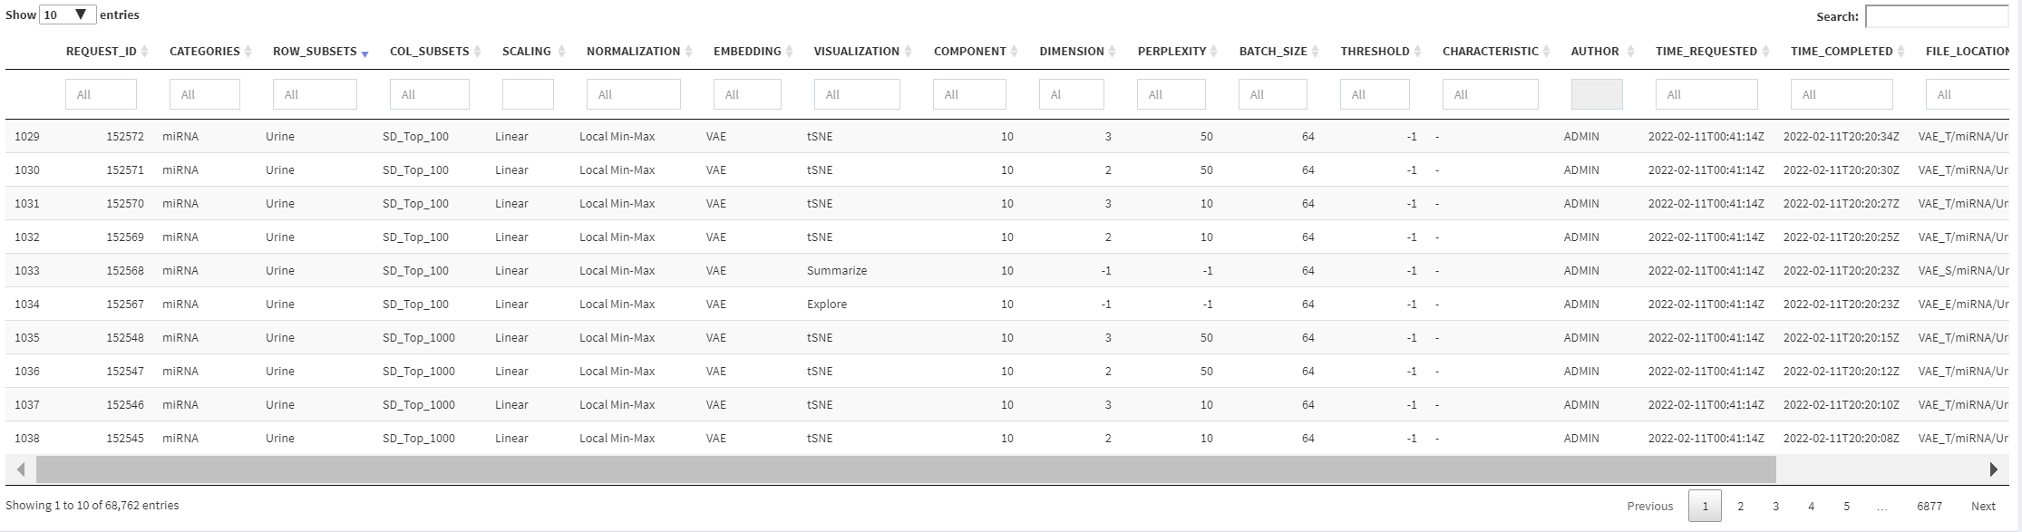
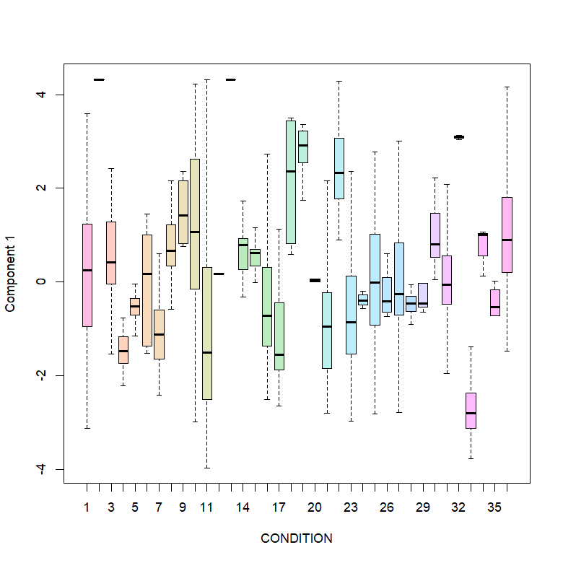
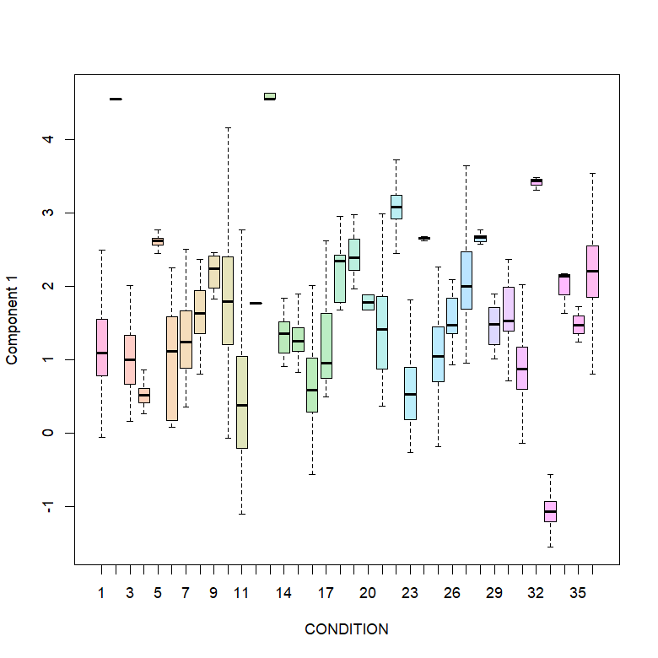
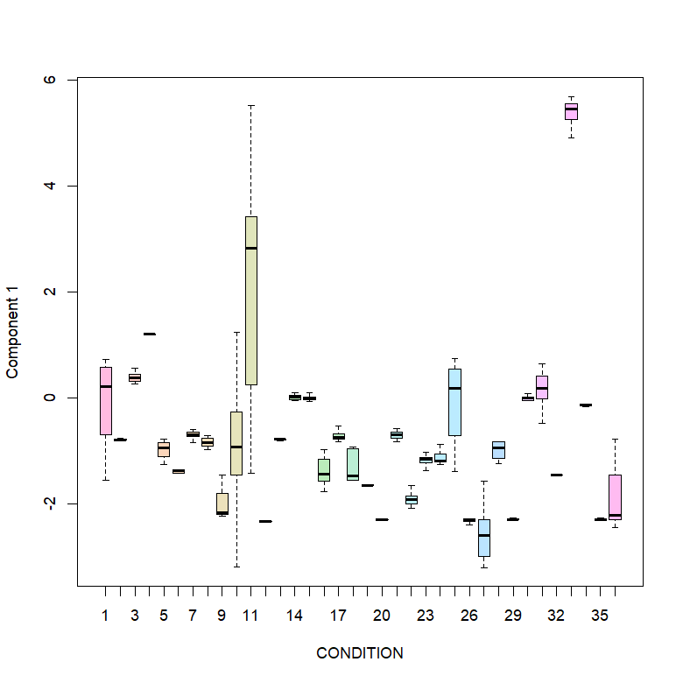
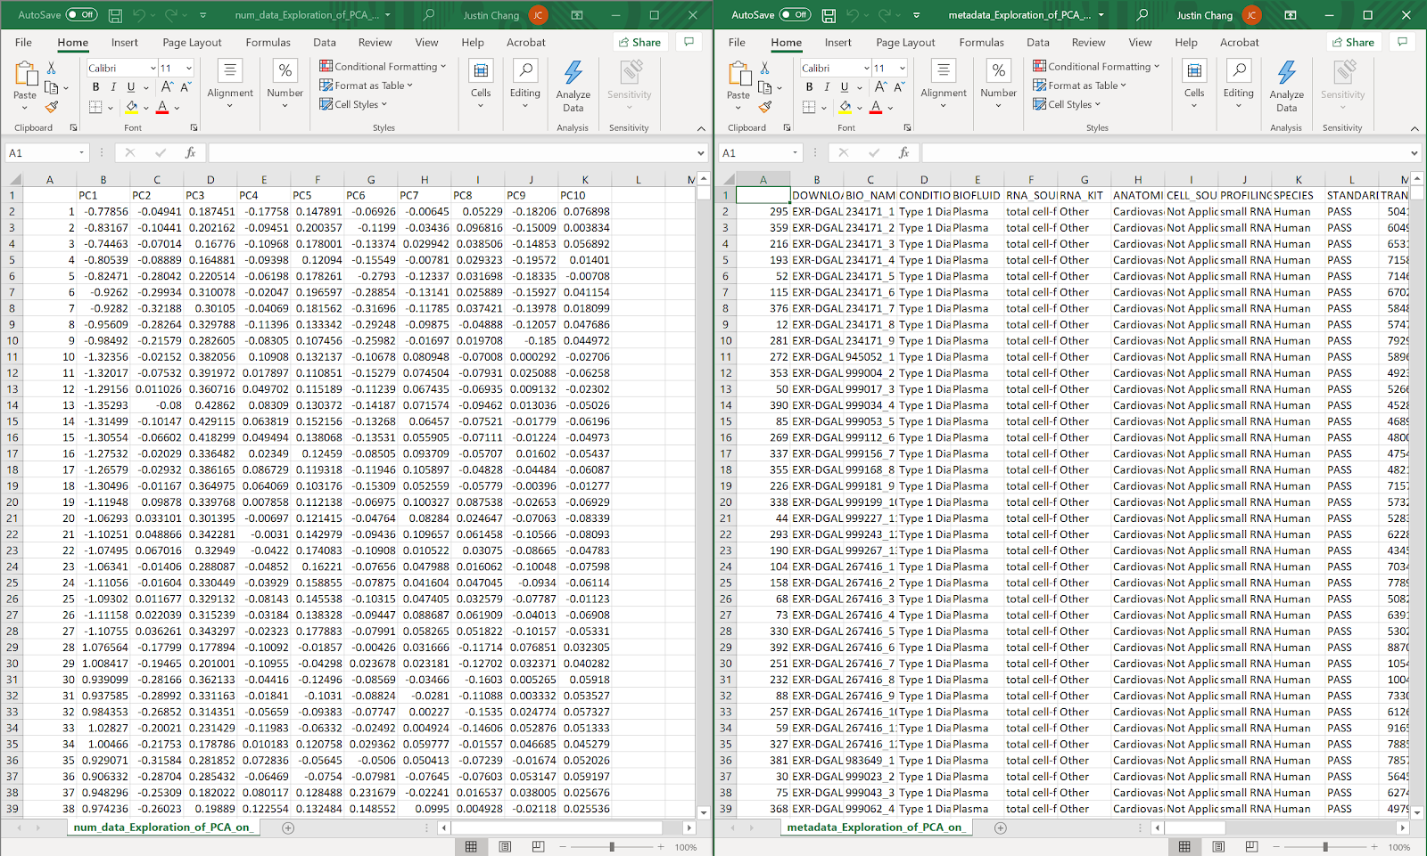
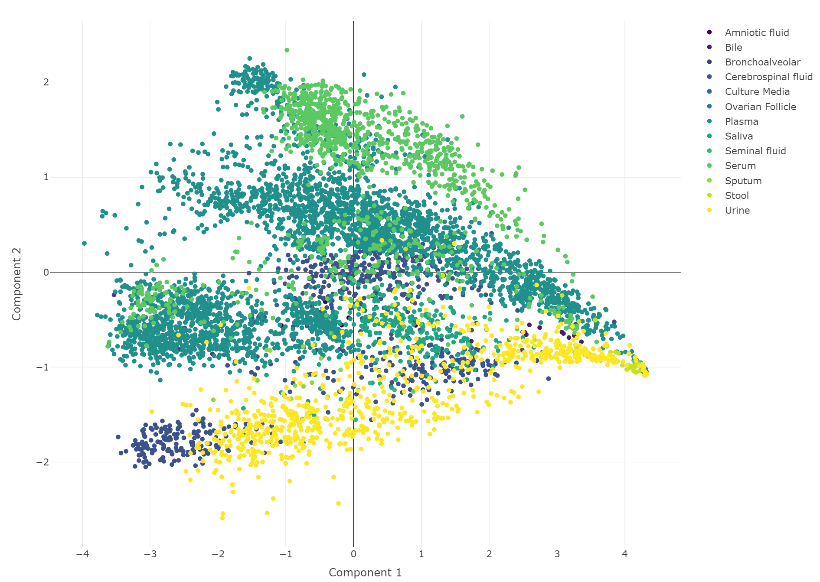
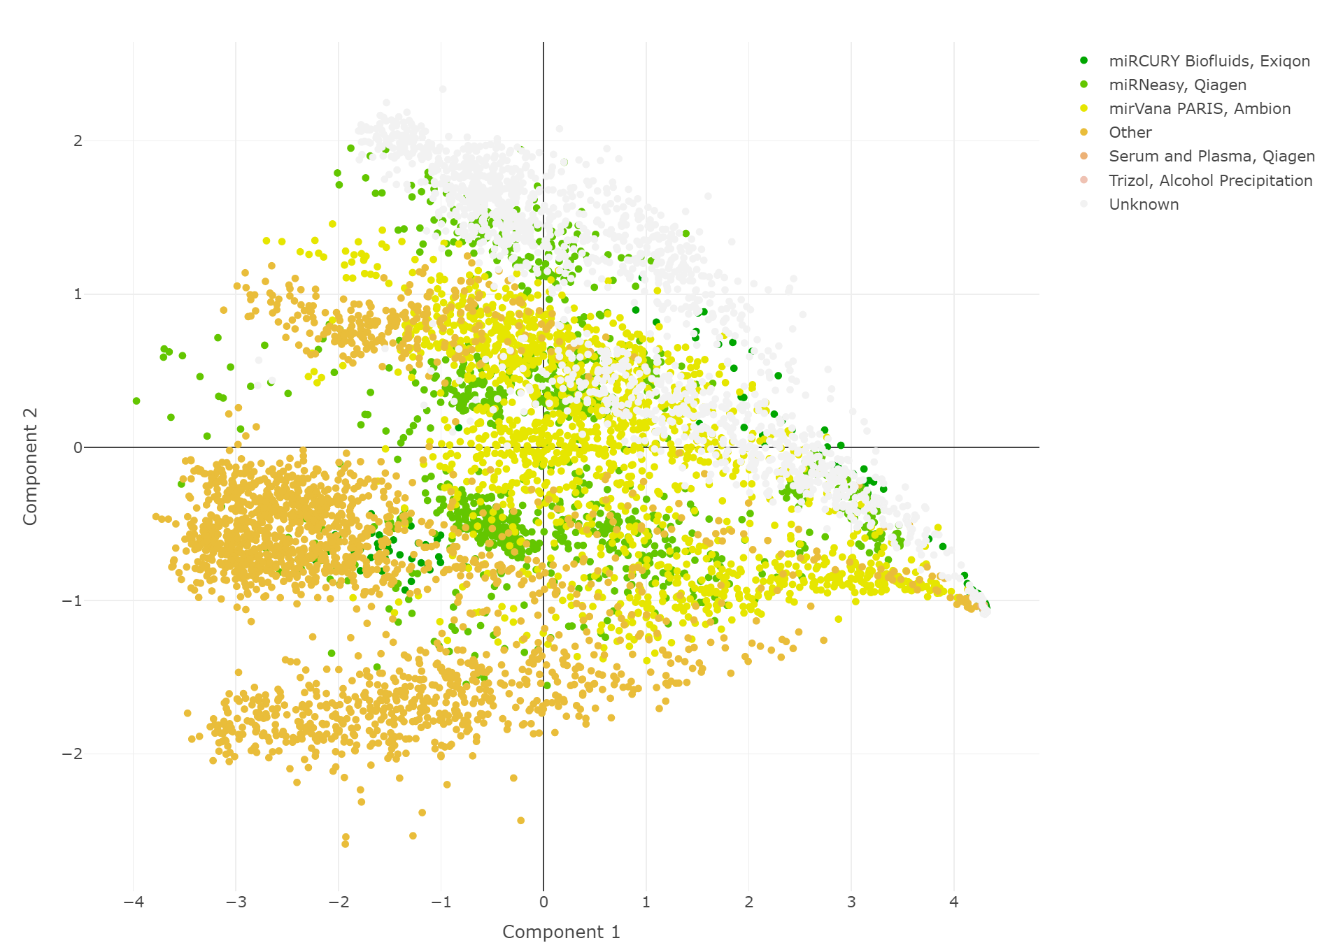
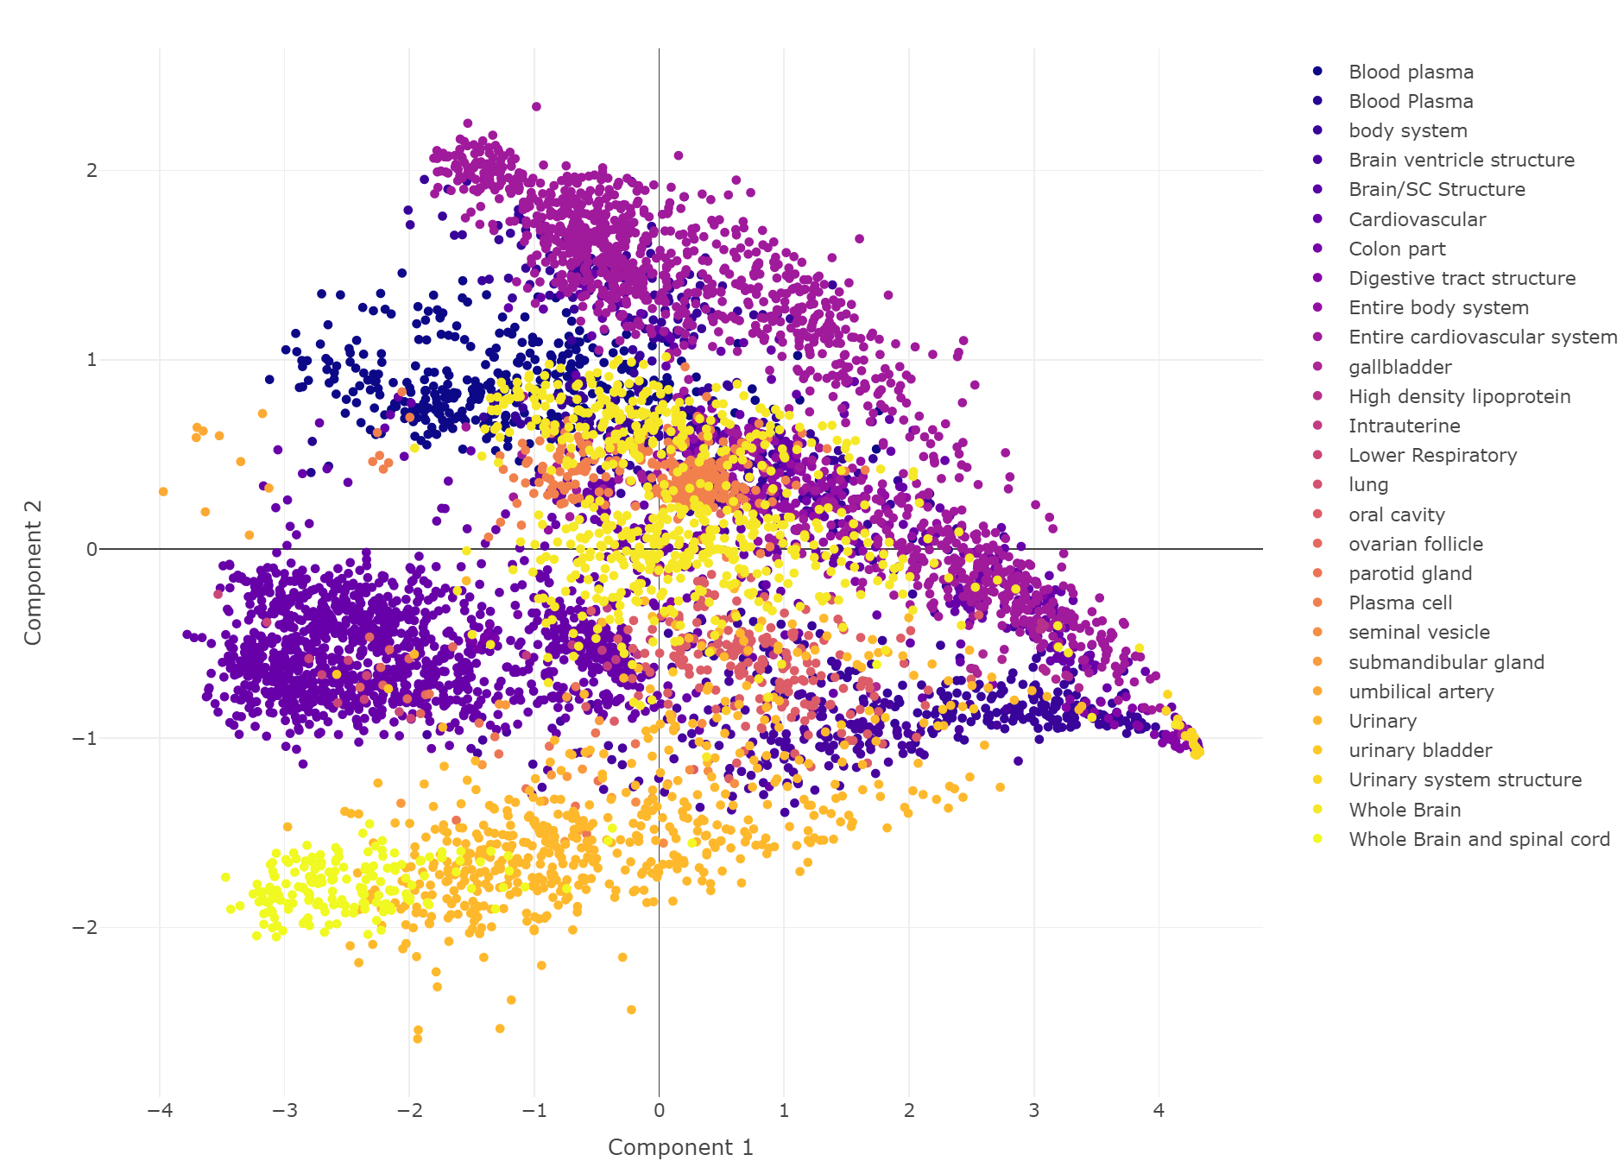
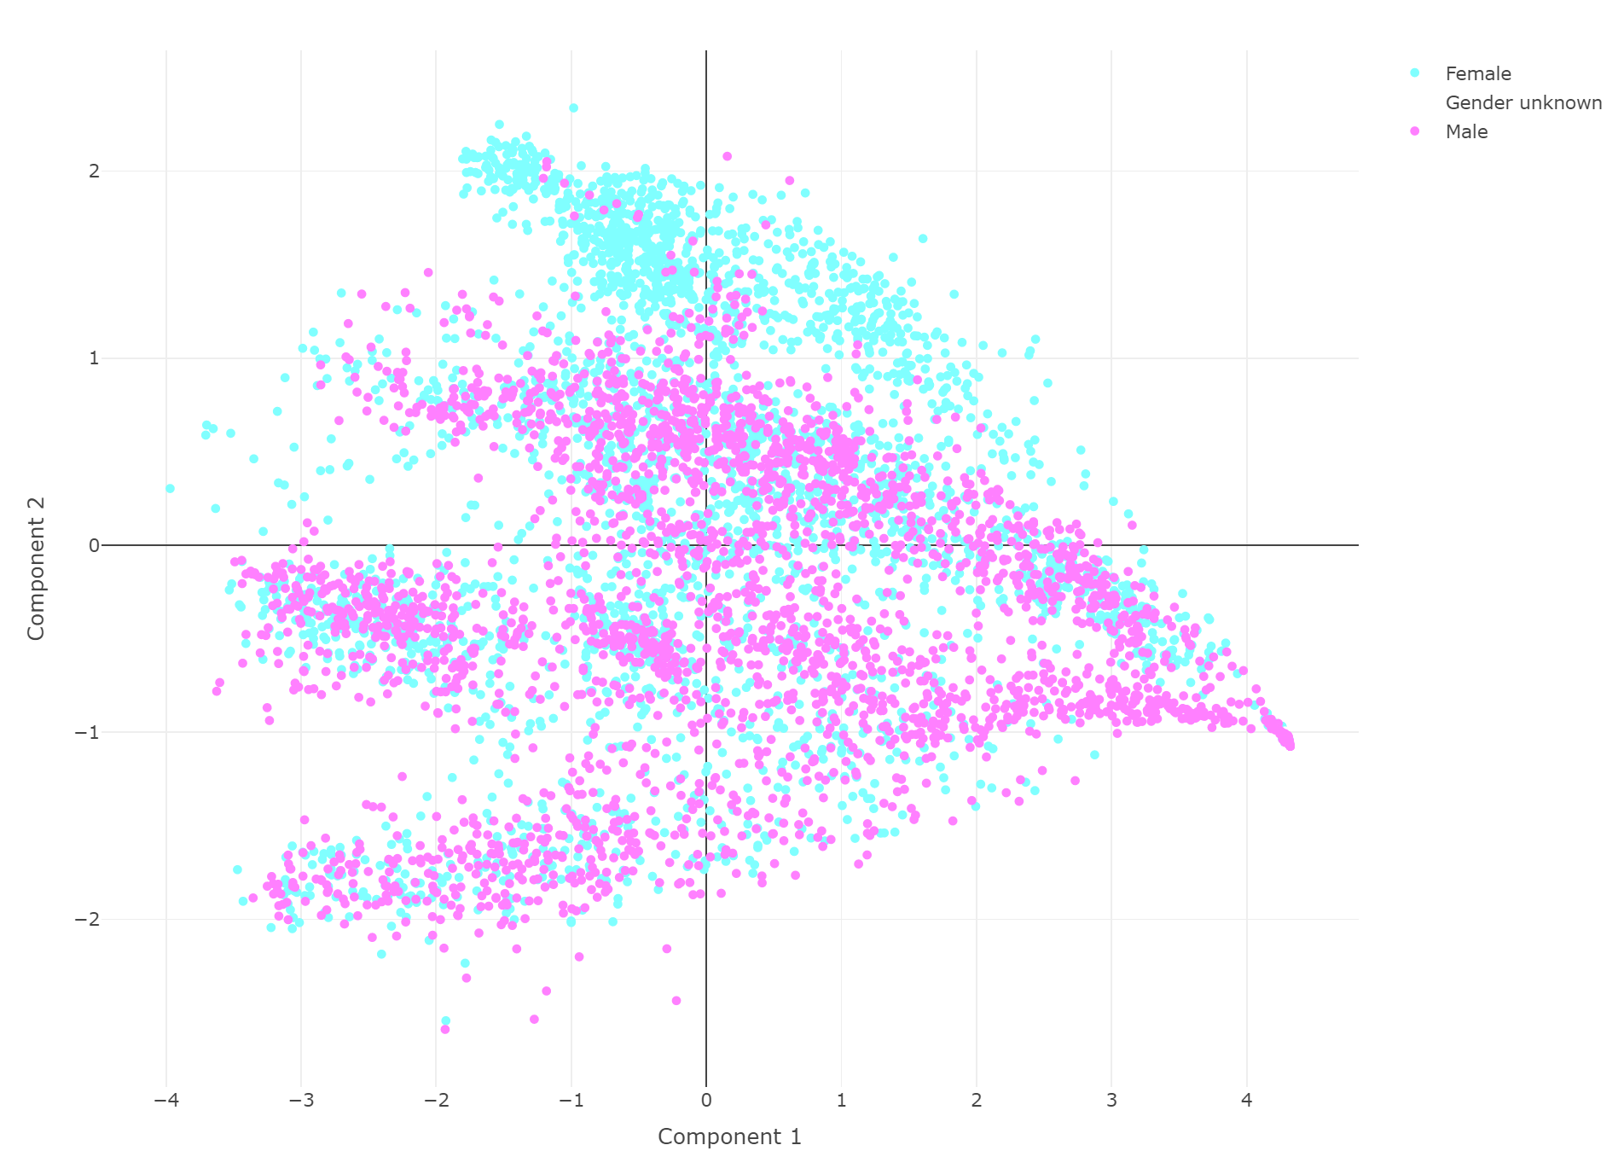
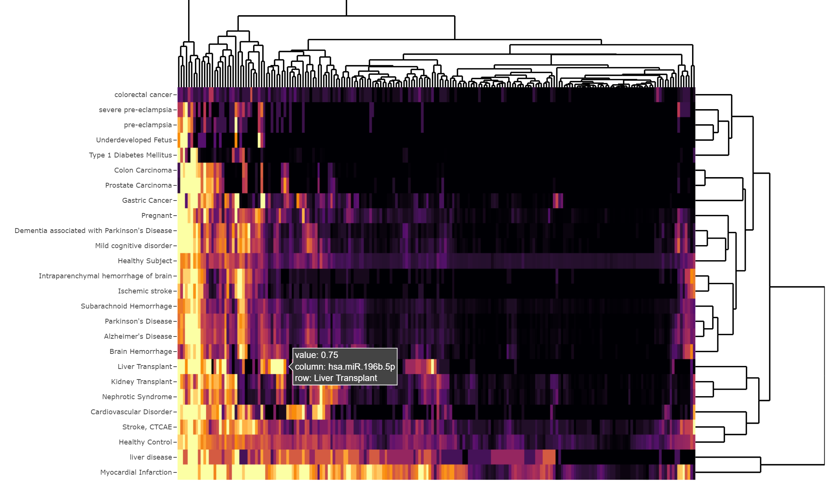
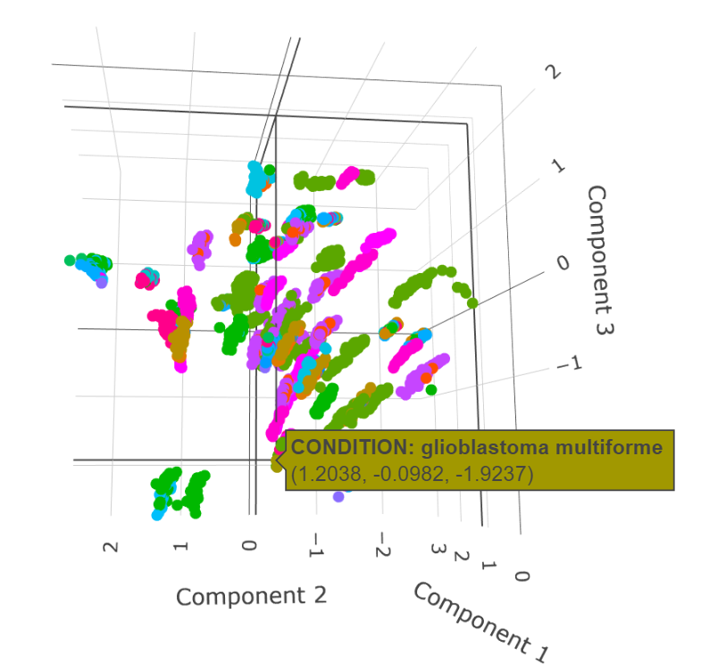
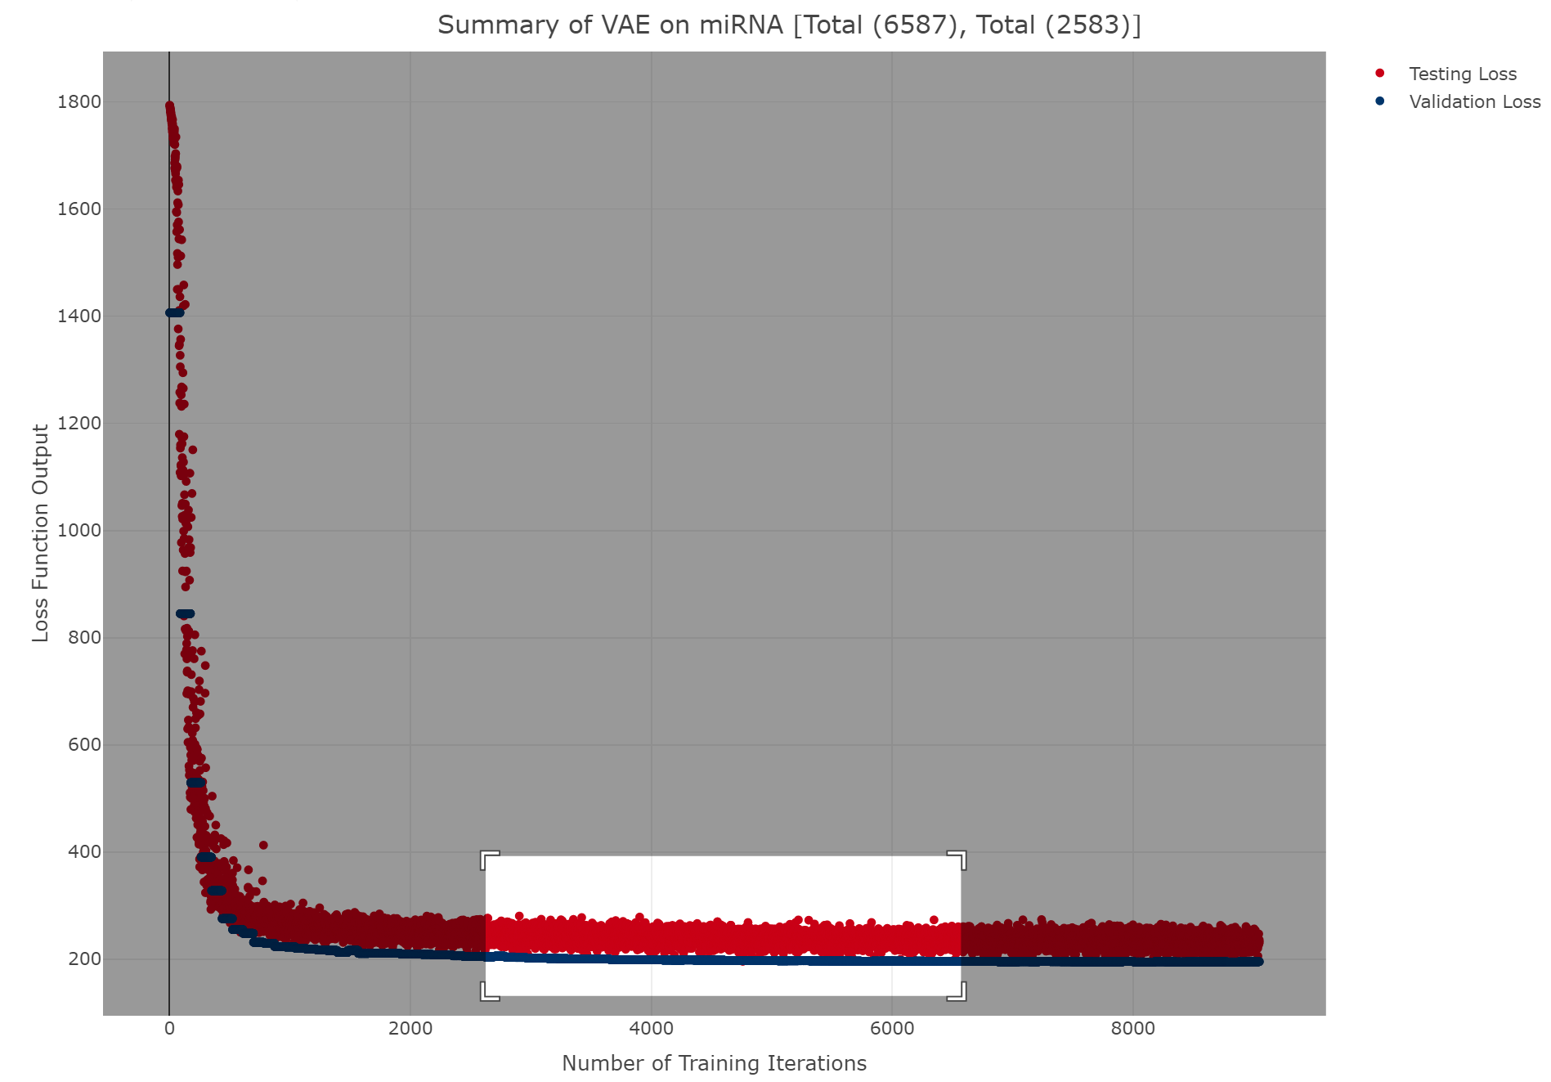
PCA
VAE
UMAP
Grouping
PHATE
Embedded Components
Color by Condition
Reduction Statistics
Custom Analyses
tSNE After
Reduction
UpSetR
Heatmap
Dendrogram
Grouped Boxplot
Downloads
Color by Biofluid
Color by RNA Kit
Color by Organ
Color by Sex
Interactive Exploration

